Slide 1
Youth Work Week 2022 23-30 June
#YWW22
#YWWellbeing

Slide 2
Introduction
Youth Work Week is a chance to celebrate the positive stories and successes from the last 12 months. It is a time to highlight stories from the Youth Work Sector and recognise the contribution that all those working in Youth Work Services have made to young people and communities.
The information provided here sets out our theme for the week and is intended to help you to get involved and promote your own activities too. Please feel free to use it as you wish across your social media channels.
Each day of the week is a chance to highlight achievements, say thank you, and increase understanding around youth work – covering youth work services in the broadest sense.
Please tag @YWWales, @Addysg_Cymraeg, and @CWVYS so that we can help you to share your stories and achieve maximum coverage during #YWW22

Slide 3
Contents
Theme and hashtags #YWW22 #YWWellbeing
Online Events and activities
Where to find visual assets/graphics to support your messages
Support for planning social media
Example text – useful (and customisable) messages that you can use on social media channels
#YWW22
Remember… if you can, let us know your plans before Youth Work Week – so we can help you to promote them and raise awareness of what’s going on in the youth work sector.

Slide 4
Theme
Our theme for Youth Work Week 2022 is ‘Wellbeing’
We will be focusing on the well-established ‘Five Ways to Wellbeing’ to help coordinate activities and encourage engagement
The Five Ways to Wellbeing are: Connect, Be Active, Take Notice, Keep Learning and Give.
For each day of Youth Work Week we will be focusing on one of these – keep an eye out for details on the @YWWales social media channels (Twitter and Facebook)
We will be using the following hashtags: #YWW22 #YWWellbeing
#YWW22
#YWWellbeing

Slide 5
Online Events and Activities
Thursday 23rd | Friday 24th​ | Monday 27th​ | Tuesday 28th​ ​ | Wednesday 29th ​ | Thursday 30th​
BE ACTIVE Wellbeing Walks with Conwy Youth Service Join in on twitter with: @YWWales and @GIConwyYS | CONNECT Connecting through cooking with Torfaen Youth Service Join in on twitter with @YWWales and @torfaenyouth | ​KEEP LEARNING Have some fun with Learn Cymraeg! Join in on twitter with @YWWales and @learncymraeg | TAKE NOTICE​ Take note of open youth work and non-formal learning to promote democracy with our Youth International Partners Mobility Networking Event @YWWales and @youthcymru | ​GIVE We’ll be giving free access to My Money Matters Courses to 10 lucky practitioners! Join in on twitter with @YWWales and @youngenterprise | BIG THANK YOU! Celebrating Youth Work Week: join in with @YWWales
16:00-17:30 Webinar Hosted by EWC and featuring Jim Sweeney (former Chief Executive of YouthLink Scotland) as our guest speaker. This event is recommended for practitioners and all stakeholders working with young people. Register here | ​ |  | ​10:00-12.00 Free online course ‘Building Resilience for Youth Workers’ This course is being offered free during Youth Work Week by Victoria English, Award winning speaker, lecturer and Mental Health consultant. Register here |  | ​
Sign up!
…to two special Youth Work Week online events
Look out for…
messages on Twitter from the Minister for Education and the Welsh Language, as well as the Chair of the Implementation Board for Youth Work in Wales. Follow @YWWales
#YWWellbeing
#YWW22

Slide 6
Visual Assets
The visual assets (provided separately) can be used whenever you wish to promote #YWW22 and our #YWWellbeing theme.
Content/messaging for the visuals is:
Five Ways to Wellbeing #YWW22 #YWWellbeing
Inspire others, share your stories #YWW22 #YWWellbeing
It’s time to say a big THANKS #YWW22 #YWWellbeing
Let’s celebrate #YWW22 #YWWellbeing
For social media

Slide 7
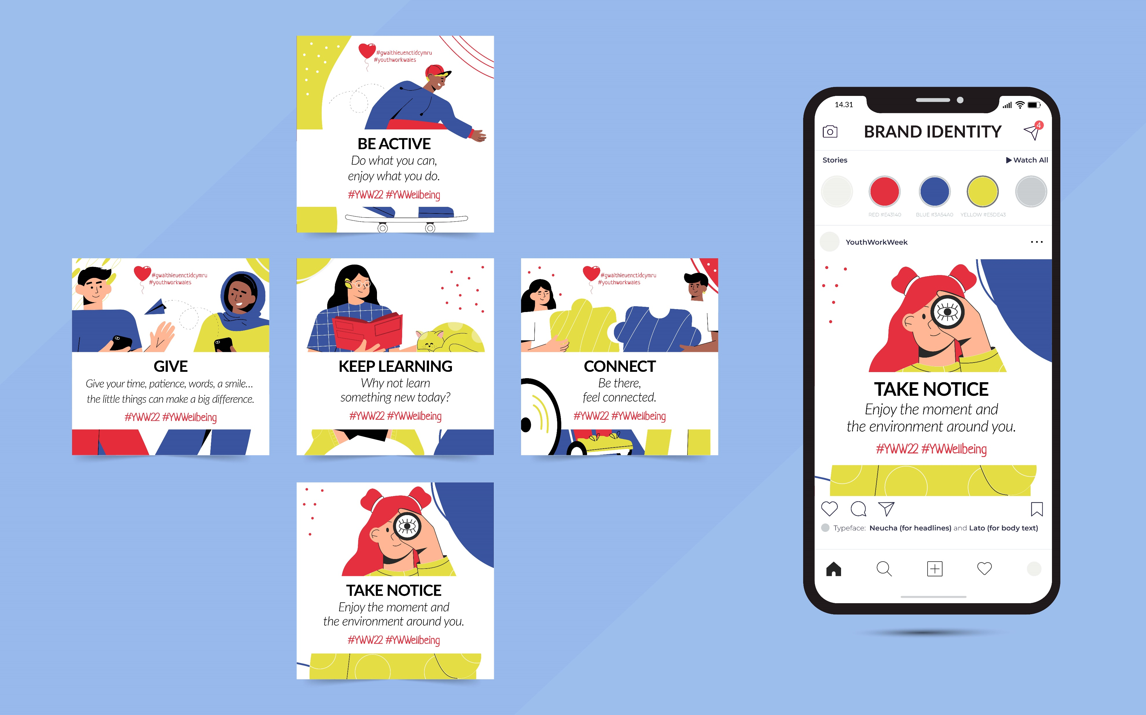

Slide 8
Support
The examples below are all intended to be used and/or customised as you wish. Top tips are:
Use one of the visuals provided on your posts if you don’t have your own images/photos/videos
Keep posts short and focus on encouraging your main audience to respond and interact with you
Please tag @YWWales @Addysg_Cymraeg and @CWVYS wherever you can so that we can help share your messages and highlight #YWW22
with social media

Slide 9
for social media
Example text for facebook OR TWITTER
[To be used with your own photos/videos - or one of the images provided]
Today is the start of Youth Work Week in Wales – and it’s a chance to celebrate our amazing youth workers and their contributions to the lives of young people across Wales.
There are lots of ways to get involved!
Find out more with @YWWales #YWW22 #YWWellbeing
Tag: @YWWales @CWVYS @Addysg_Cymraeg
Text

Slide 10
for social media
Example text for facebook OR TWITTER
[To be used with your own photos/videos - or one of the images provided]
Happy #YWW22 – it’s time to celebrate the youth work sector and all the opportunities it offers.
Let’s share our stories and give our young people and youth workers the recognition they deserve.
There are lots of ways to get involved!
Find out more with @YWWales #YWW22 #YWWellbeing
Tag: @YWWales @CWVYS @Addysg_Cymraeg
Text

Slide 11
case study introduction
Example text for Case study
[Note – this example needs someone to be willing to provide a short video clip talking about their experience of youth work]
This week is Youth Work Week in Wales – and it’s a chance to celebrate our youth workers’ contribution to the lives of young people across Wales #YWW22.
Here’s [Name/s] to tell you [his/her/their] story of how youth work influenced and inspired [him/her/them].
Find out more with @YWWales #YWW22 #YWWellbeing
Tag: @YWWales @CWVYS @Addysg_Cymraeg
Text

Slide 12
If you would like us to help promote any of your projects/activities during #YWW22… or you have questions, please contact
ellie@cwvys.org.uk branwen@cwvys.org.uk

